Slide 1



Getting Started with
Open Source
CS Club - EdITH Wing

Slide 2
Motivation?
Ever used a free tool or app and thought, ‘How is this even made?’
Surprise — many are built by everyday people, including students like you, through something called OPEN SOURCE!

Slide 3
Prerequisites
Nope. Just Curiosity!
But if you want to explore a bit more after the session:
🛠 Git Basics – Learn the magic behind version control [GitHub Docs]
💻 Basic Coding Skills – Any language you love (Python, C++, JS — all welcome!)
🌐 Create a GitHub Account – It’s free and your new tech resume!

Slide 4
Open Source: What & Why?
What is it?
Free to view, use, edit, and share code.
Built by people like you, not just big tech!
🛠️ Used in tools like Linux, VSCode, Firefox, OBS
Why should you care?
Learn real-world skills
Build your GitHub profile
Join programs like GSSoC & Hacktoberfest
No experience? No problem!
“Anyone can start. Even you.”

Slide 5
How Do Open Source Projects
Work?
- Code lives on GitHub – it’s like a home for projects.
- Issues are created when bugs or ideas pop up.
- You fix something (code, docs, anything!) and suggest a change via a Pull Request (PR).
- Maintainers review your work — if it looks good, it's merged into the project!

Slide 6
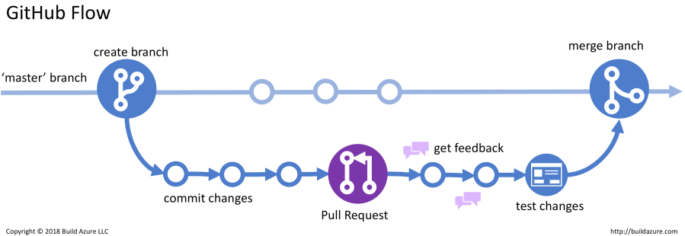
Git & GitHub Basics
Git: Your code’s time machine — tracks every change.
Key Commands: git clone, git commit -m "message", git push.
GitHub: The social hub to share & collaborate on projects.

Slide 7
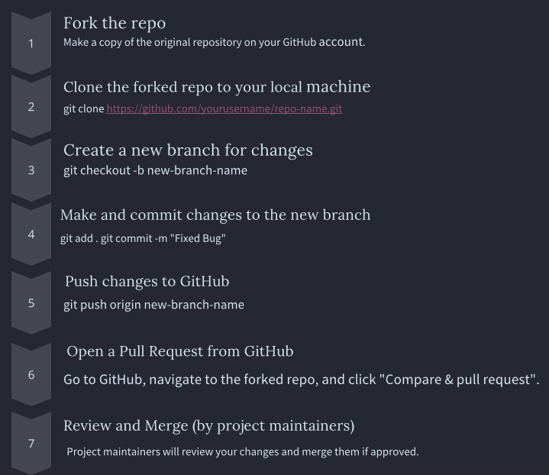
Workflow
Forking: Making a copy of someone else's repo under your GitHub account. Useful for open-source projects where you don't have direct access to the main repo.
Cloning: Copying the forked repository from GitHub to your local machine so you can work on it locally.
Branching: Creating separate "work areas" within the repository. Branches allow working on new features without affecting the main code.

Slide 8
Live Demo
Let’s see the Open Source workflow in action! ⚙️ Fork → Clone → Branch → Commit → Push → Pull Request
I'll walk you through how to make your first open source contribution — live!
Still confused? Once go through https://github.com/firstcontributions/first-contributions

Slide 9
Finding Projects
Look for tags like:
good first issue
beginner friendly
Websites:
goodfirstissue.dev
up-for-grabs.net
Start with docs or UI if you’re nervous to code

Slide 10
How to Be a Great Contributor
Read the project’s README and CONTRIBUTING.md
Always be respectful
Don’t submit spammy PRs just for events
Ask doubts—community is there to help!

Slide 11
Open Source Programs for Students
GSSoC – India, beginner-friendly
Hacktoberfest – Every October
GSoC – Global, with stipend
Outreachy – For underrepresented groups
KWoC, SWoC, MLH Fellowship

Slide 12
Cool Project Ideas for Beginners
Fix small bugs & earn your first PR
Help improve docs for fellow learners
Design simple web pages or tweak UI
Build fun scripts to automate tasks
Translate docs to reach more people

Slide 13
Open Source = Career Power-Up
Your GitHub is your tech resume — recruiters love seeing real code, not just marks.
Contributions show you're a team player, problem solver, and self-starter.
Opens doors to internships at the big leagues:
Google • Microsoft • Red Hat • Cool Startups
Build in public. Be seen. Get hired.

Slide 14
Q & A : Ask Us Anything
The floor’s yours — no question is too small!
Curious minds welcome — let’s explore together!
Every great journey starts with a question.

Slide 15



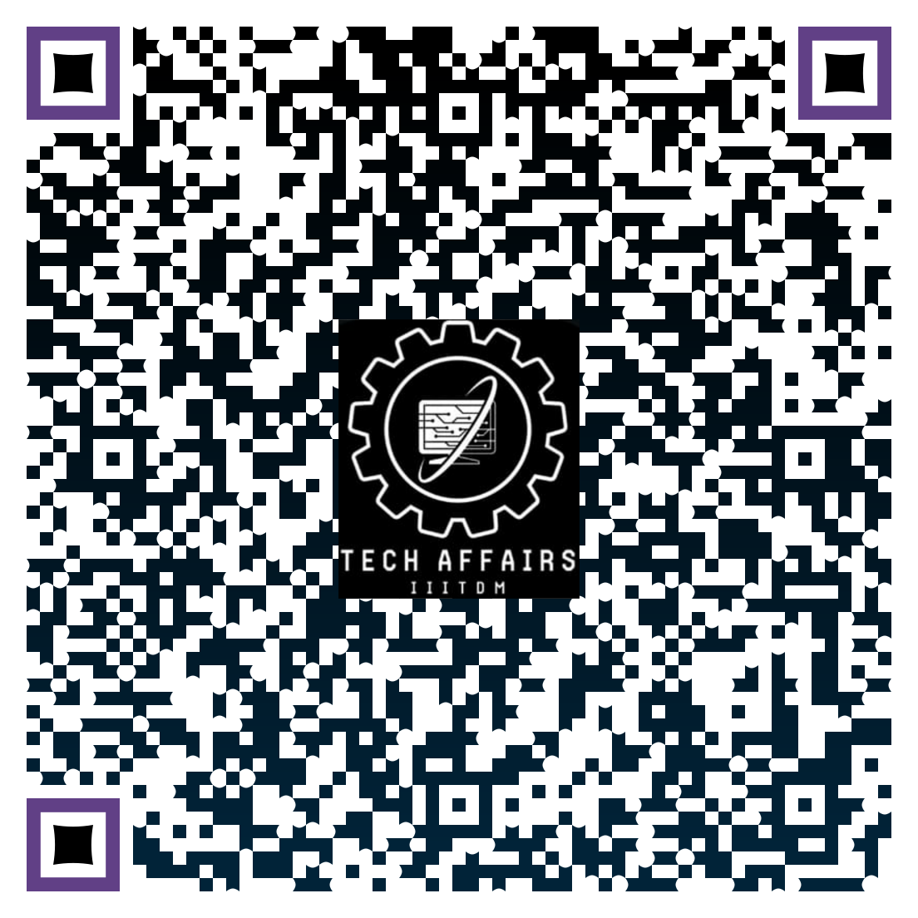
Connect with us
Instagram
LinkedIn
Whatsapp
GC
emails
or linktree
CS club Insta
CS club LinkedIn
Tech Affairs WhatsApp Channel
Tech Affairs Linktree

Slide 16
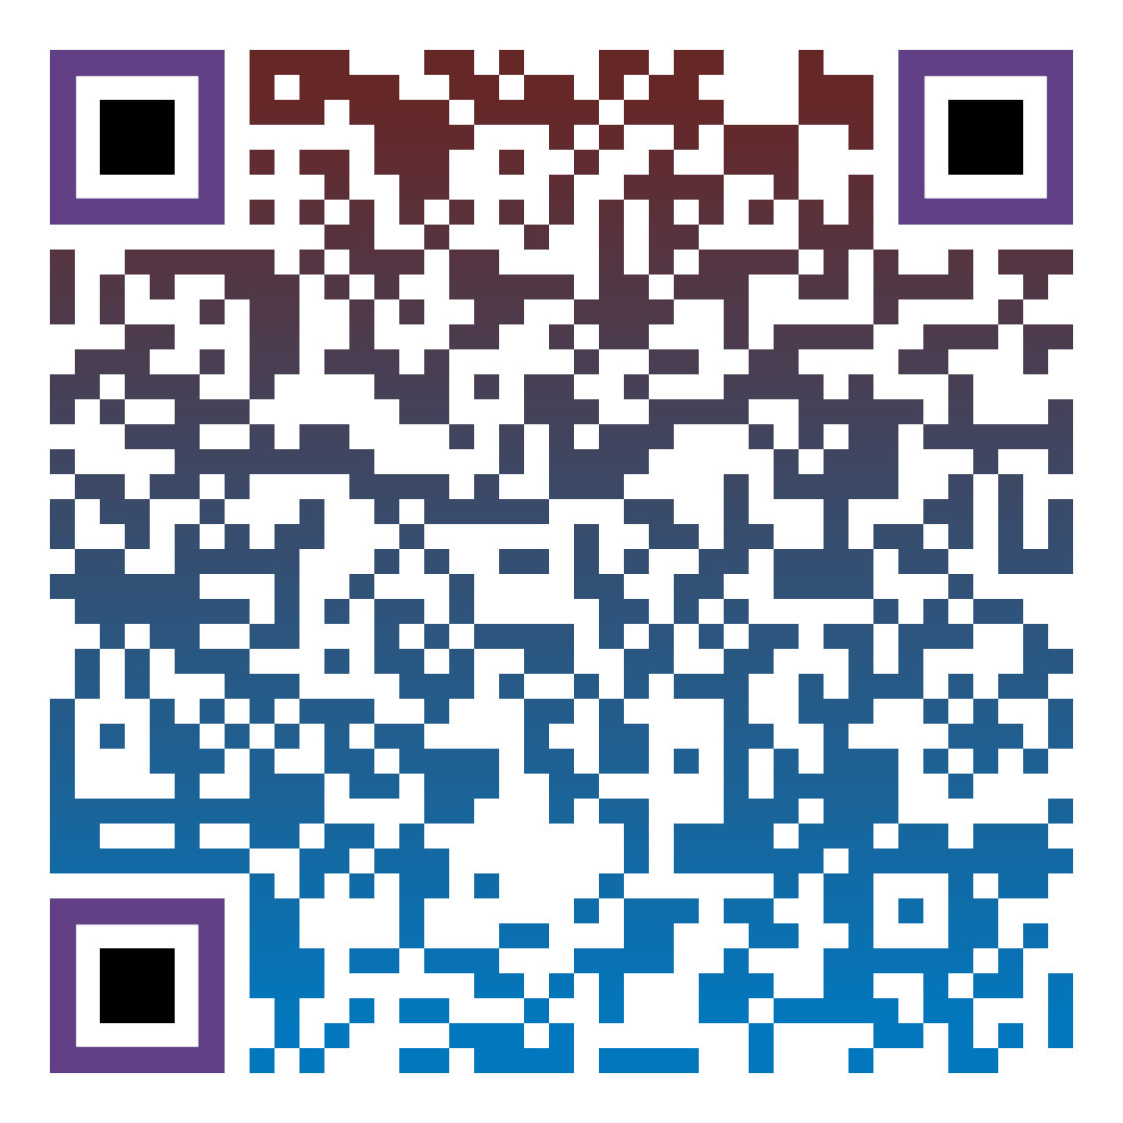
Thank You
“Start small, start today “
Share your valuable feedback with us regarding this session by scanning the QR below

